Slide 1
Financial Performance Analysis
Power BI Implementation

Slide 2
Problem Statement & Objectives
Objectives
Track Income & Expenses
Monitor Net Profit over time
Compare Budget vs Actual
Identify High-Cost
Departments
Analyze Monthly Trends
Calculate KPIs:
Cost-to-Income Ratio
YoY Profit Growth
Variance %
Problem Statement
A financial services firm wants to automate its financial reporting using Power BI. The goal is to track income, expenses, and profitability across departments and time periods. The dashboard should provide insights into budget vs actuals, cost centers, and financial KPIs. It should support drill-down analysis and help CFOs make strategic decisions.

Slide 3
Expected Outcomes
Clear financial performance visibility
Department-wise income & expense insights
Early detection of losses
Improved budget monitoring
Better strategic decision-making
Data-driven support for CFO

Slide 4
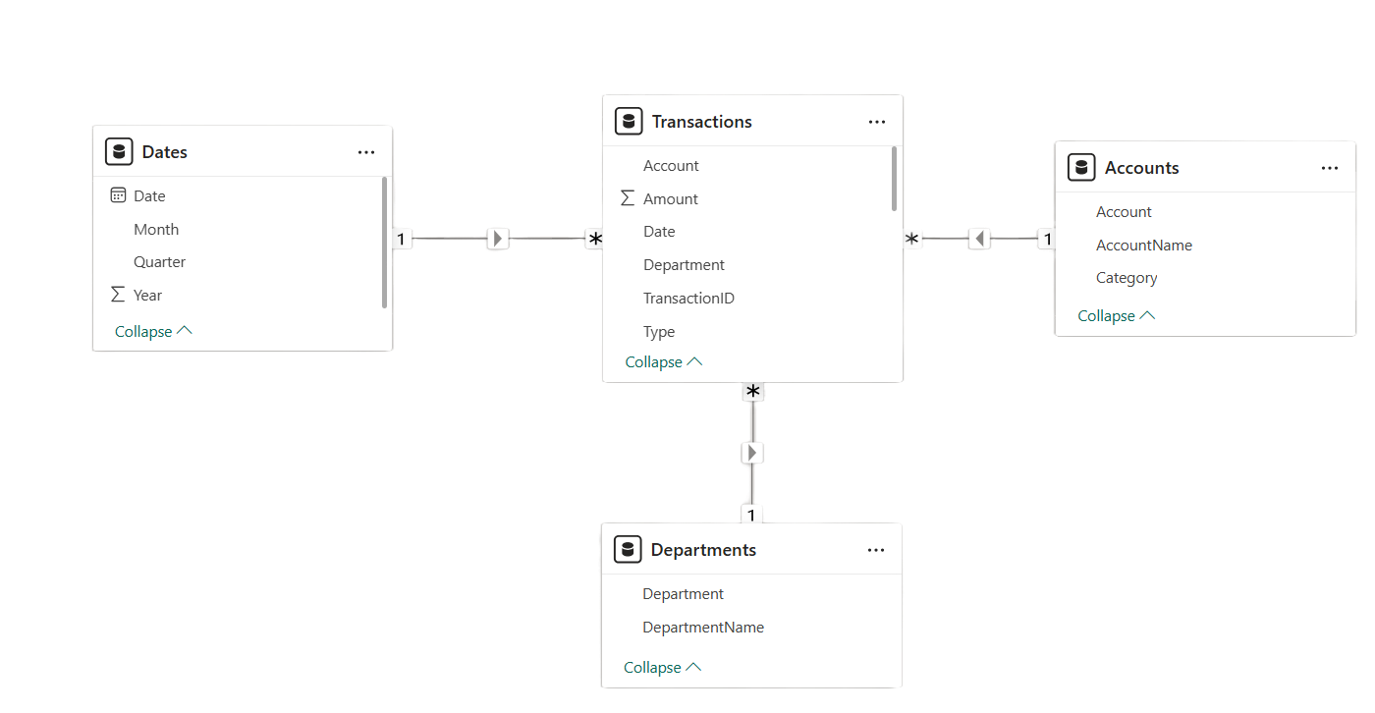
Dataset and Model
Dataset Used
The dashboard uses four tables:
Transactions → financial records
Accounts → account categories
Departments → department information
Dates → time analysis
Data Model
Transactions → Accounts (Foreign Key)
Transactions → Departments (Foreign Key)
Transactions → Dates (Foreign Key)
This follows a star schema model for efficient analysis.

Slide 5






Key Performance Indicators (KPIs)
Financial Health Overview
The company generated ₹1,845.07M in total income.
Total expenses reached ₹1,884.56M, leading to a net loss of ₹39.49M.
The Cost-to-Income Ratio (102.14%) indicates expenses exceeded income.
Despite current loss, YoY Profit Growth of 19.24% shows improvement over last year.
The -9.09% variance highlights underperformance against the planned budget.

Slide 6
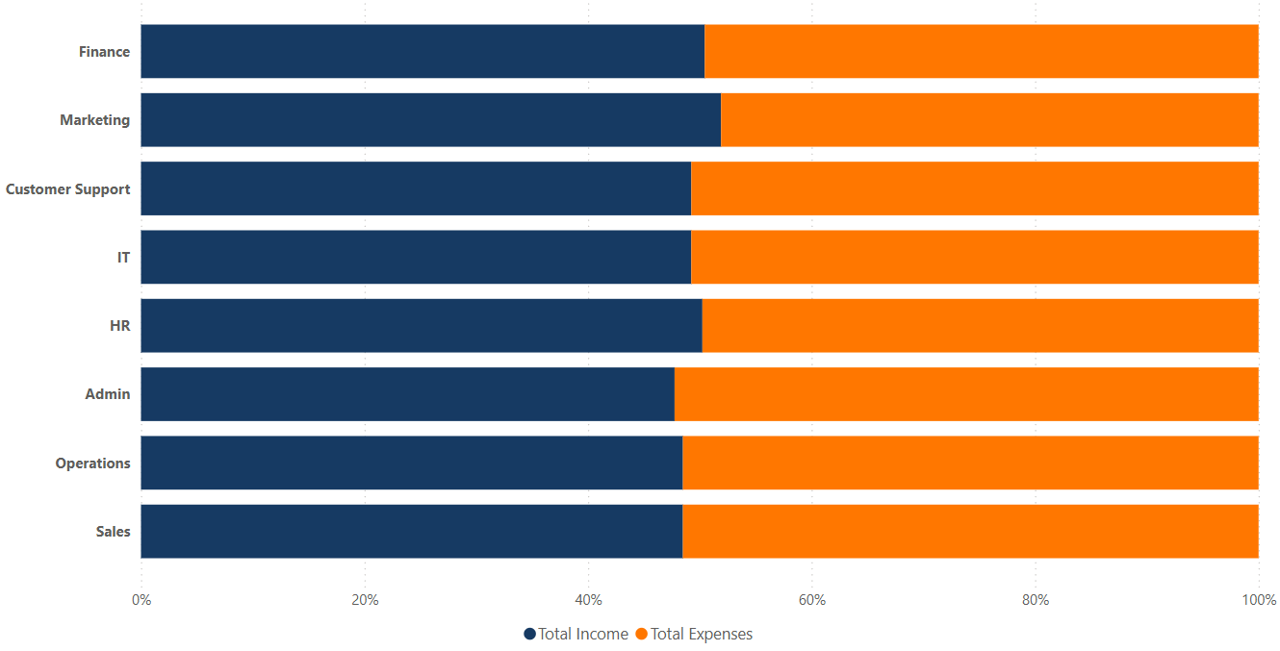
Department-Level Financial Analysis
Key Observations:
Comparison of Total Income vs Total Expenses
across departments
Some departments generate strong revenue but also incur high costs
Certain departments show expenses close to or exceeding income
Helps identify cost centers and profit-driving departments
Business Impact:
Supports department-wise performance evaluation
Helps management control high operational costs
Enables better resource allocation decisions

Slide 7
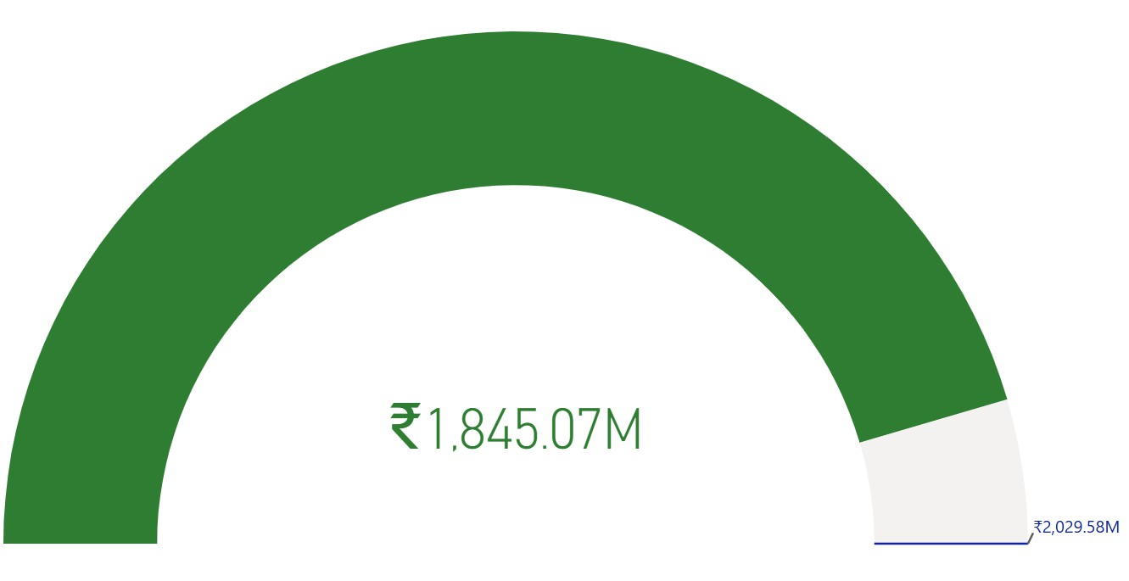
Budget vs Actual Performance
Insights:
Actual performance is below planned target
Revenue shortfall impacts overall profitability
Indicates need for improved forecasting and revenue strategies
Helps management monitor financial goal achievement
Business Importance:
Tracks whether company is meeting financial expectations
Supports corrective actions in budgeting and planning
Enhances accountability across departments

Slide 8
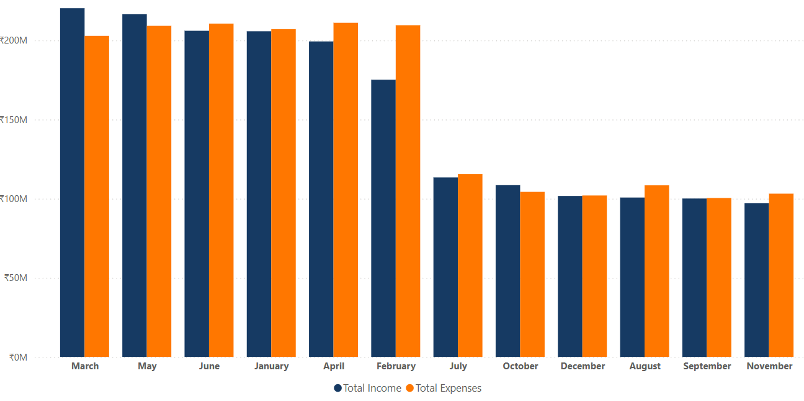
Monthly Income vs Expense Trend
Key Observations:
Income and expenses fluctuate across months
Early months show relatively higher income levels
Mid-year shows noticeable decline in revenue
Expenses remain consistently high throughout the year
Narrow gap between income and expenses impacts profitability
Business Insights:
Identifies seasonal performance patterns
Highlights months with potential financial pressure
Supports better monthly budgeting and forecasting
Helps management plan cost-control strategies

Slide 9
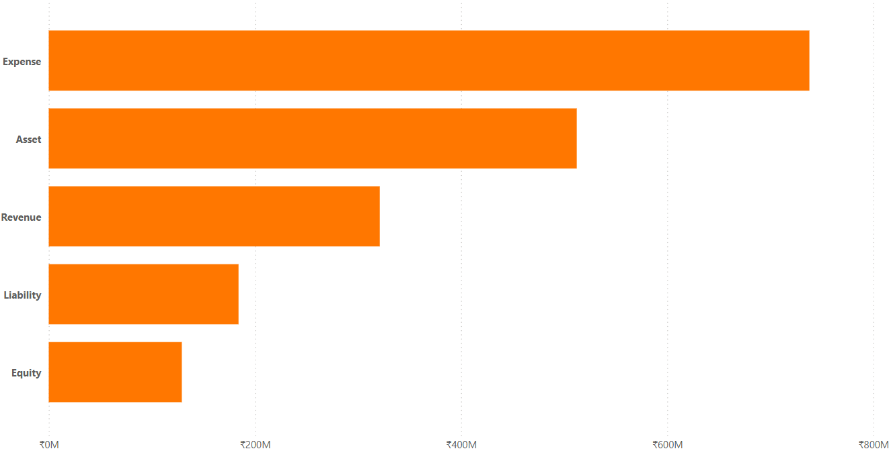
Top Expense Categories Analysis
Key Observations:
Expense category contributes the highest financial outflow
Followed by Asset-related expenditures
Revenue and Liability categories show moderate impact
Equity contributes the least to total financial movement
Business Insights:
Major spending concentrated in Expense accounts
Indicates high operational cost structure
Cost optimization should focus on dominant expense categories
Helps management prioritize financial control areas

Slide 10

Conclusion & Key Takeaways
The Financial Performance Dashboard successfully automates reporting and provides a centralized, interactive view of income, expenses, profitability, and budget performance.
Analysis shows that total expenses exceeded total income, resulting in a net loss and a Cost-to-Income ratio above 100%, indicating operational inefficiency.
Although budget targets were not fully achieved, positive Year-over- Year growth reflects improvement and potential for financial recovery.
Strategic focus should be on cost optimization, strengthening revenue streams, and continuous KPI monitoring to support data- driven decision-making.

